Slide 1
Introducing the time axis in genomic prediction and association studies
Malachy Campbell
VT GWAS Workshop
6/26/2019

Slide 2
What is a phenotype?

Slide 3
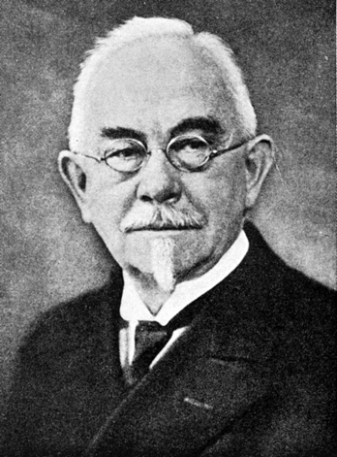
Conceptual basis of phenotyping
“All ‘types’ of organisms, distinguishable by direct inspection or only by finer methods of measuring or description, may be characterized as ‘phenotypes’… the description of the myriads of phenotypes as to forms, structures, sizes, colors and other characters of the living organisms has been the chief aim of natural history, −which was ever a science of essentially morphological-descriptive character….Hence we may adequately define this conception as a ‘phenotype-conception’ in opposition to the ‘genotype-conception’.”
Wilhelm Johannsen, 1911

Slide 4
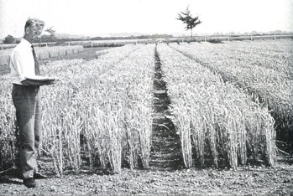

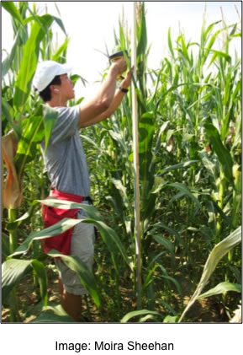
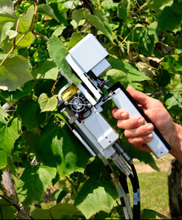
Classical phenotyping approaches
http://www.plantphysiol.org/content/164/1/173
Plot level: Flowering time
(days to 50% anthesis)
https://www.integratedbreeding.net/
Plant level: Height, plant architecture, etc.
http://www.licor.com
Organ level: Leaf shape, photosynthesis
Notes:
Phenotyping often refers to using some metric to quantify some observable characteristic
There is often a trade off between how much precision we can use to describe how a plant or population of plants looks and how many we can evaluate in a given day (either due to the cost of labor or the cost of the equipment)

Slide 5
What is the phenome?

Slide 6
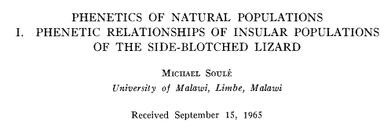
The phenome
Phenome: “the phenotype as a whole…” - Michael Soulé
“high-dimensional phenotypic data … the structure, function and performance of large numbers of plants, together with their environment” – Tardieu et al (2017)
http://dx.doi.org/10.1016/j.cub.2017.05.055

Slide 7

Capturing the phenome
Seth Weinberg, Upitt
FaceBase Project
https://www.facebase.org/about/presentations/Weinberg_FaceBase_Meeting_WeinbergMarazita_06032010.pptx
Notes:
How do you collect enough phenotypic data to accurately describe an individual?

Slide 8
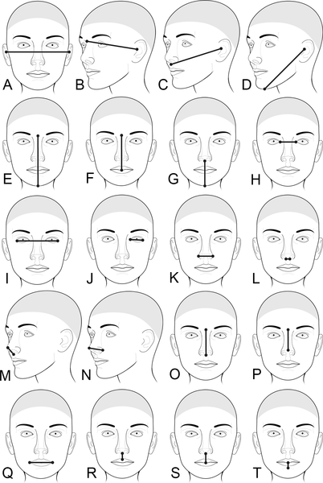
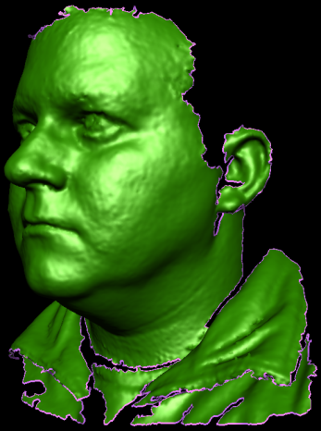
Capturing the phenome
Seth Weinberg, Upitt
FaceBase Project
http://journals.plos.org/plosgenetics/article?id=10.1371/journal.pgen.1006149
https://www.facebase.org/about/presentations/Weinberg_FaceBase_Meeting_WeinbergMarazita_06032010.pptx
Notes:
How do you collect enough phenotypic data to accurately describe an individual?

Slide 9
Straightforward application for traits measured once per experimental unit
https://www.integratedbreeding.net/
Notes:
Basic forms work extremely well for traits measured in a conventional way.

Slide 10
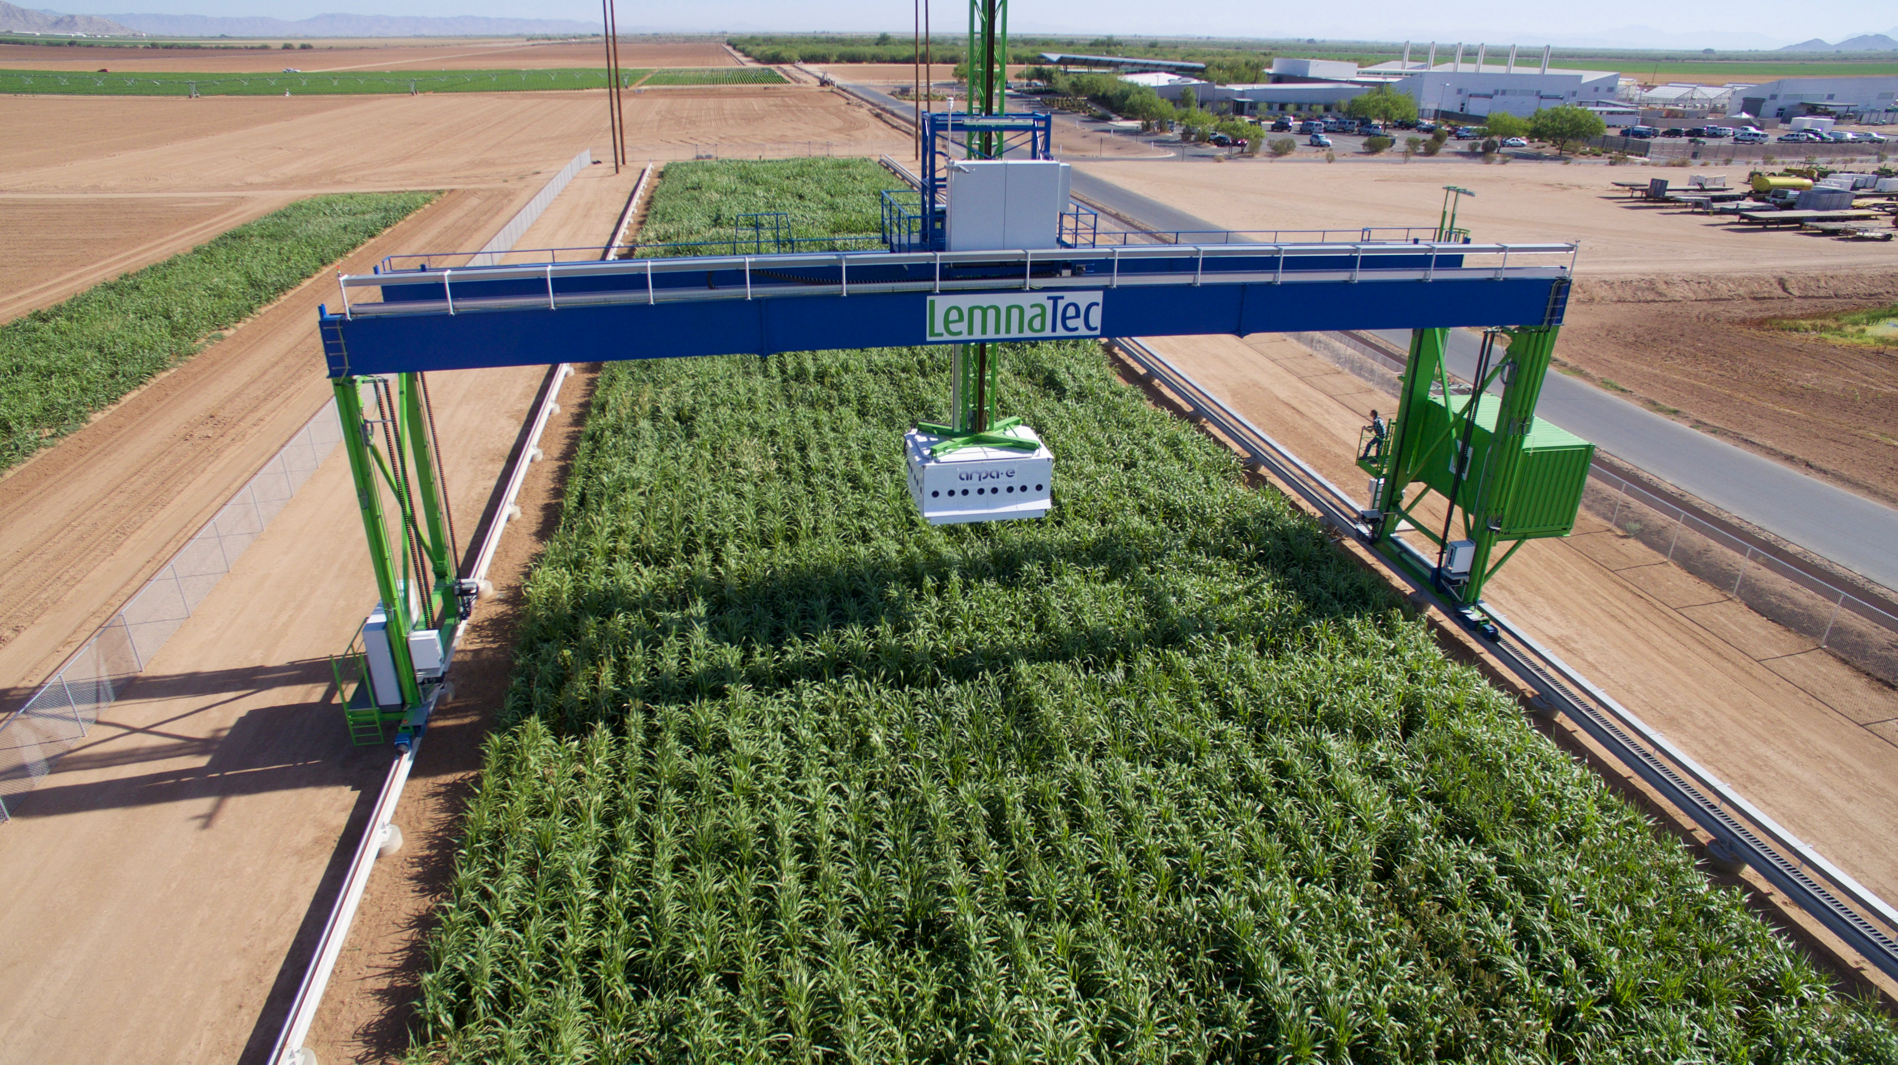
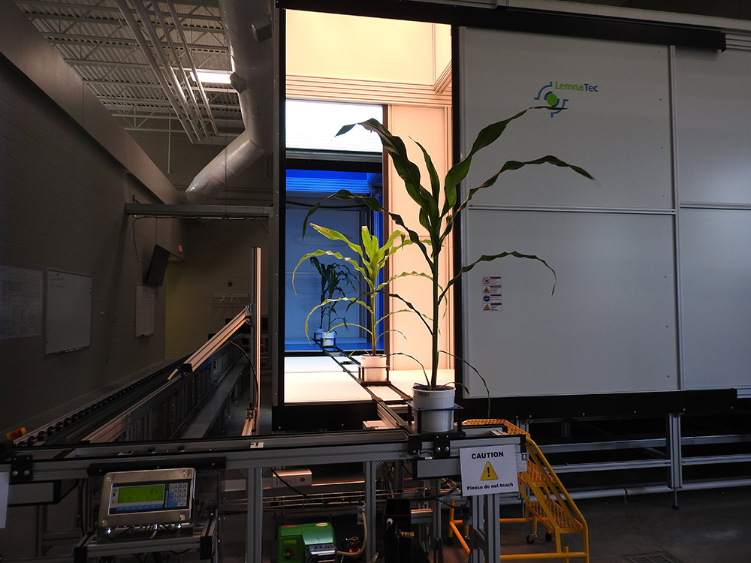
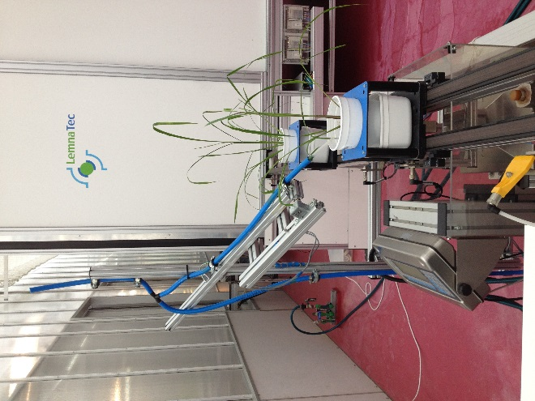
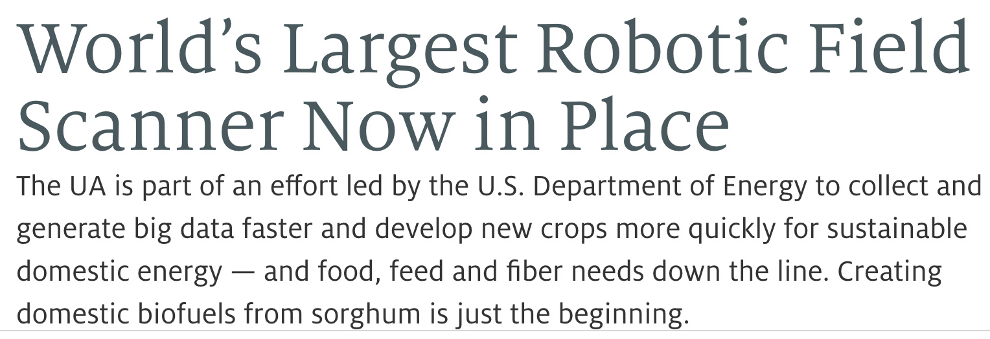
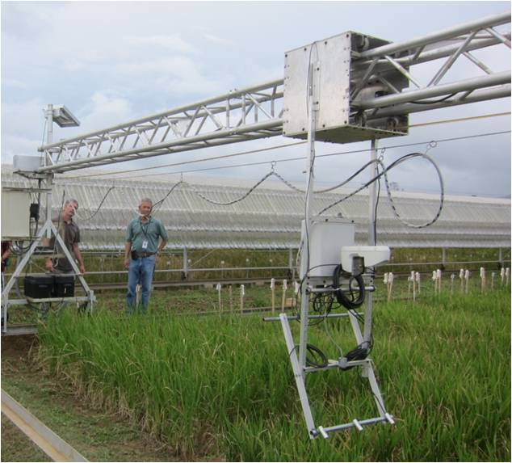
UA
UNL
http://www.fieldphenomics.org/research/vehicles
APPF
https://uanews.arizona.edu/story/world-s-largest-robotic-field-scanner-now-place
IRRI
Notes:
We are utilizing robotics to automate phneotyping and are generating very non-conventional phneotypes.
Using these systems we can assess many different characteristics for a large population of plants at frequent time intervals.
Moreover, with many of these systems we are also collecting a large amount of environmental data
Now we have to modify these approaches to deal with these high dimensional phenotypes.

Slide 11
UA
UNL
http://www.fieldphenomics.org/research/vehicles
https://uanews.arizona.edu/story/world-s-largest-robotic-field-scanner-now-place
How to adapt conventional approaches to high dimensional traits?
Time axis
Secondary traits
Environmental covariates
APPF
IRRI
Notes:
Dimensionality in terms of how often we measure traits
How other secondary traits contribute to our primary trait of interest.
One of the challenges for plant breeders and geneticists is how we use this data to improve or better understand the genetics of our primary trait or traits of interest.

Slide 12
UA
UNL
http://www.fieldphenomics.org/research/vehicles
https://uanews.arizona.edu/story/world-s-largest-robotic-field-scanner-now-place
How to adapt conventional approaches to high dimensional traits?
Time axis
Secondary traits
Environmental covariates
APPF
IRRI
Notes:
What I will talk about today is dealing with dimensionality in time and dealing with data that has both a high time and env.

Slide 13
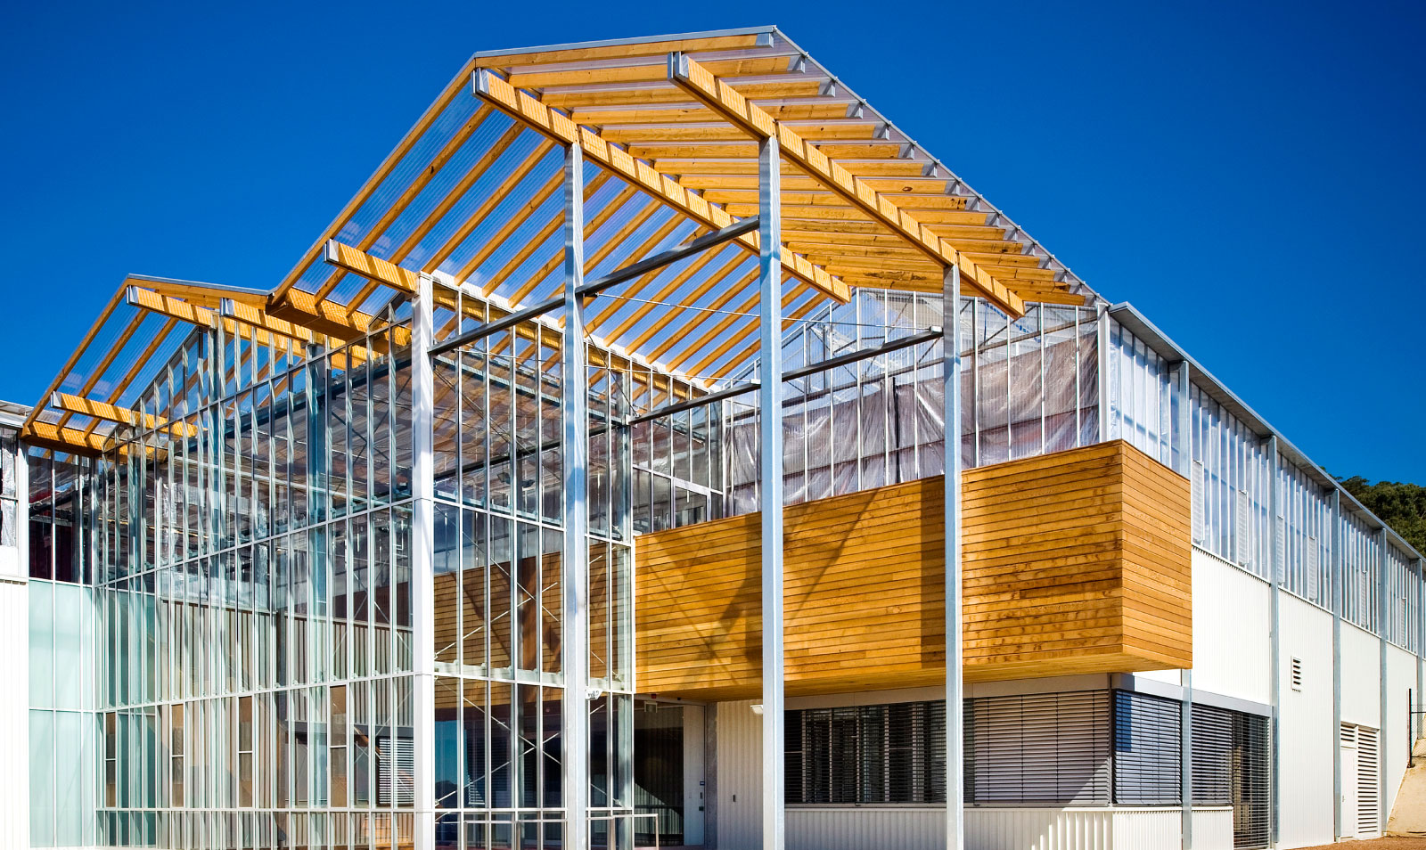
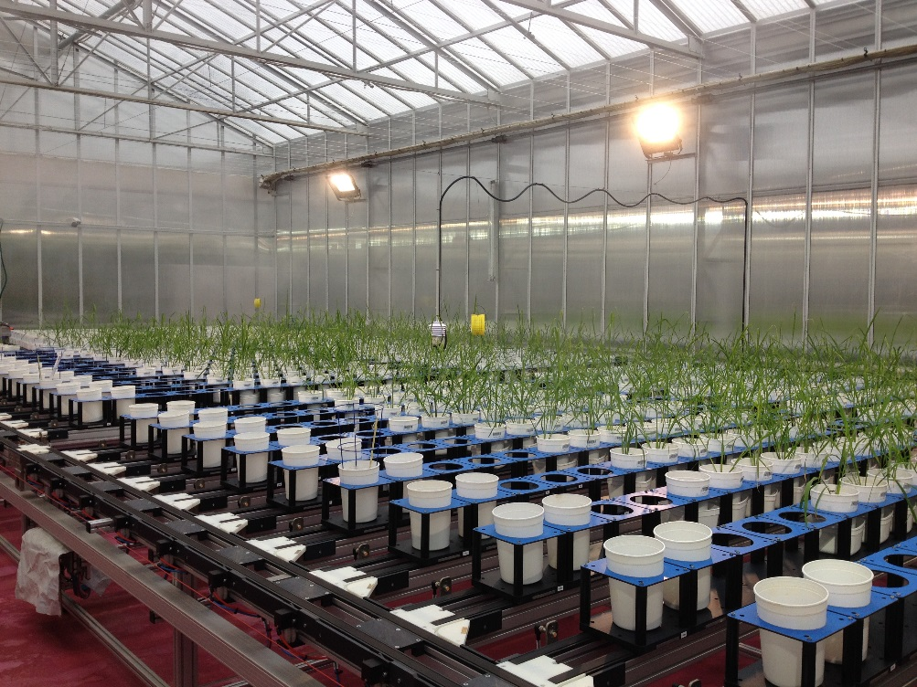

HTP for shoot growth in rice
Quantify shoot growth from RGB/VIS images from 13 to 33 days after transplant (DAT)
357 varieties
Replicated with three independent experiments from Sept-Nov 2016
Notes:
So for all the examples I will use today will be…

Slide 14
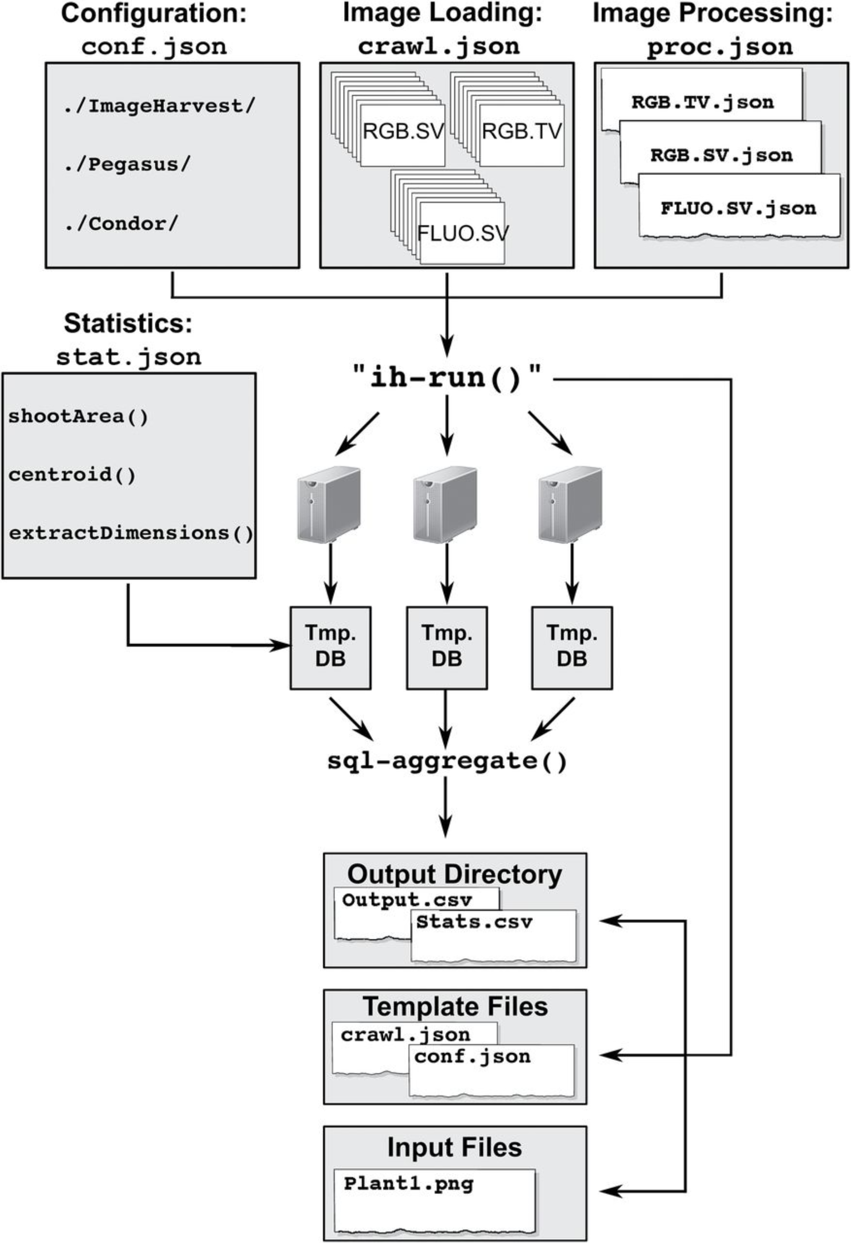
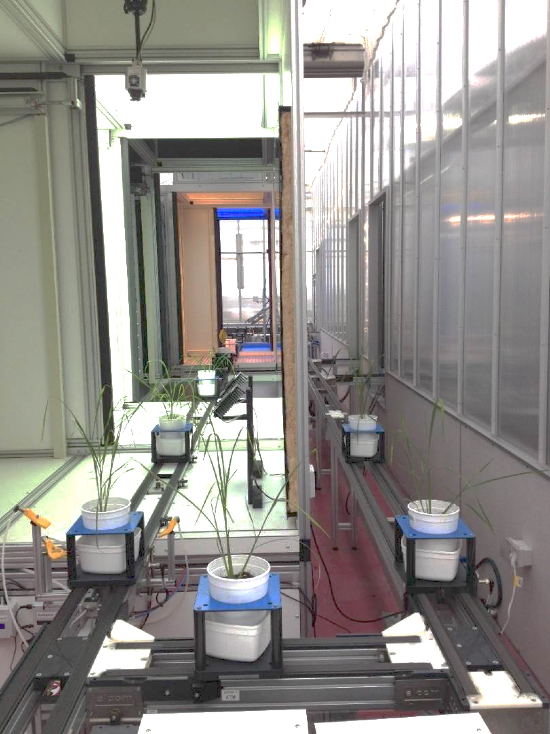
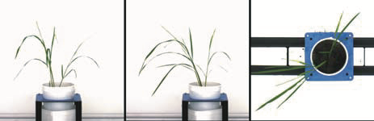
HTP for shoot growth in rice
Processing with ImageHarvest
357 accessions phenotyped over 20 days
71,537 images
Knecht et al (2016)

Slide 15
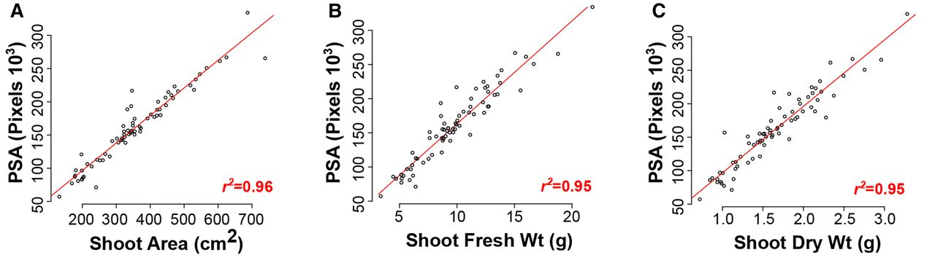
HTP for shoot growth in rice
Malachy T. Campbell et al. Plant Physiol. 2015;168:1476-1489

Slide 16
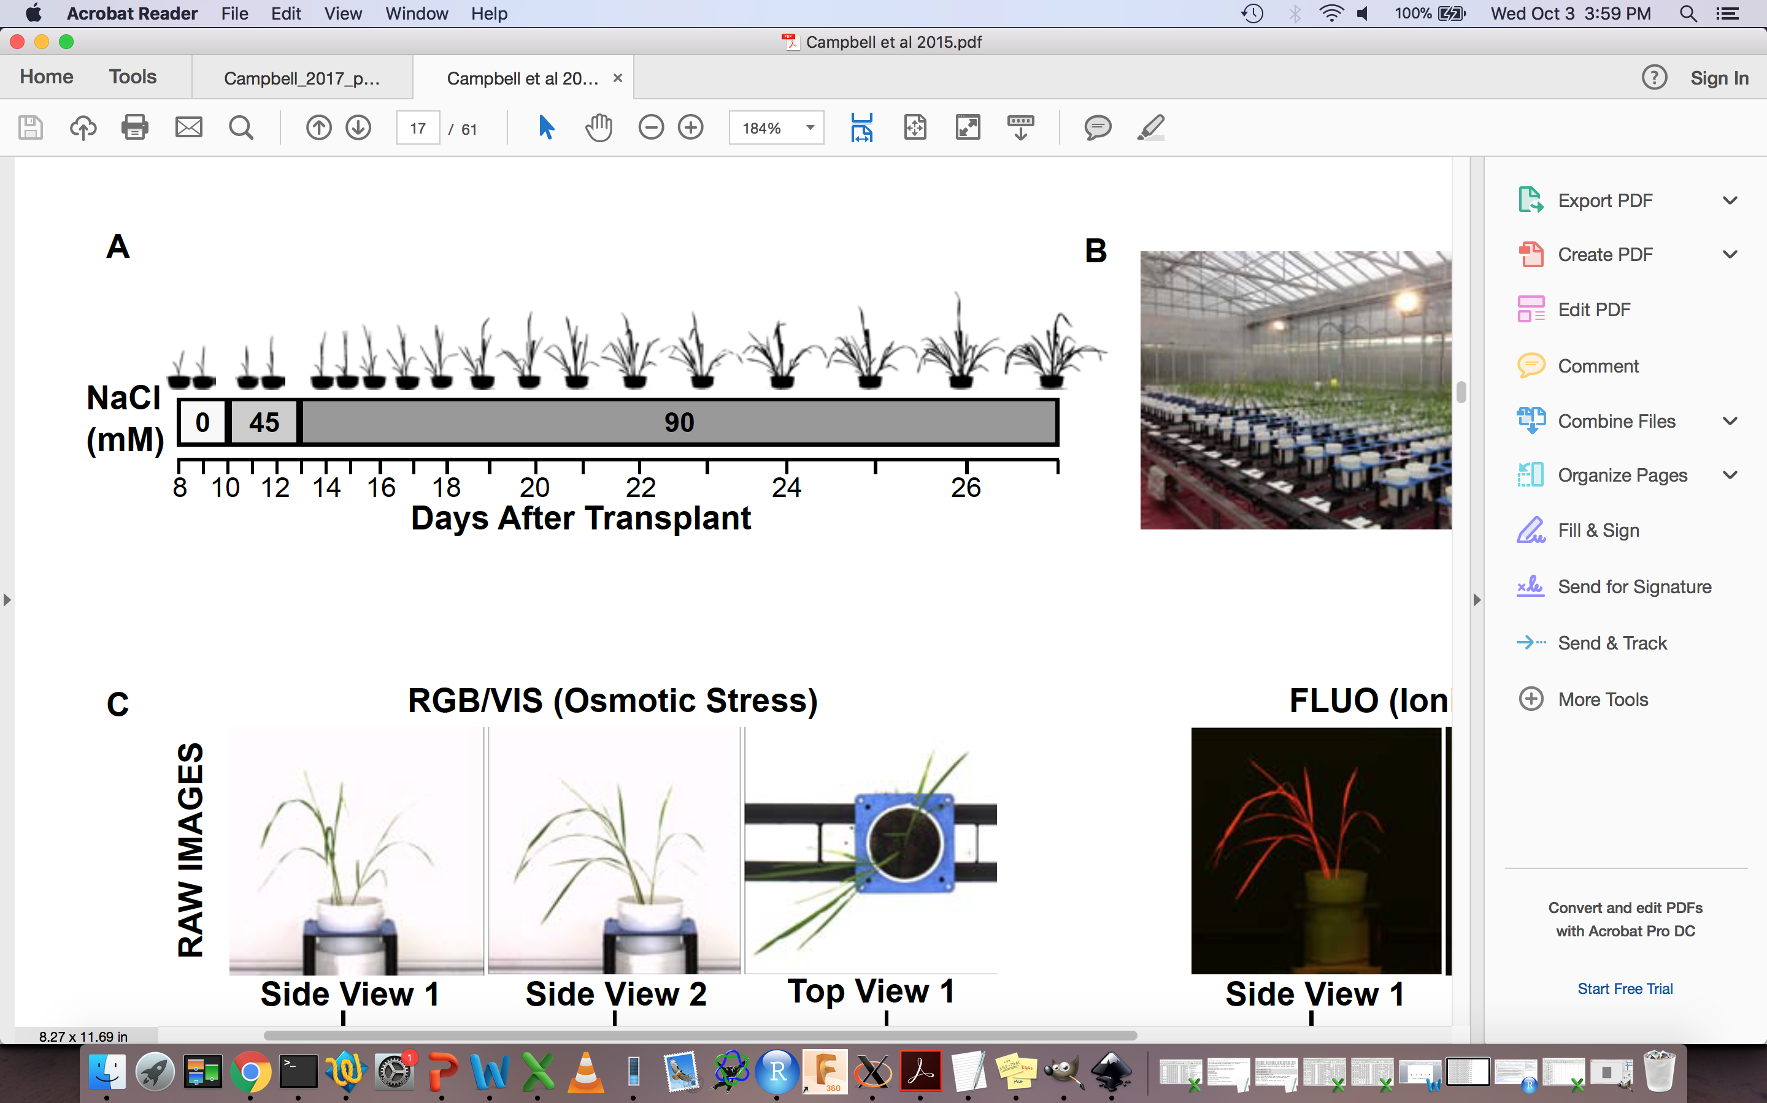
dealing with the time axis in genomic inference and prediction

Slide 17
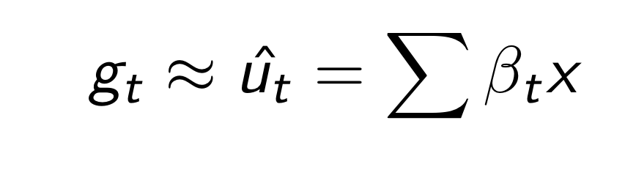
Genomic prediction for temporal traits
Can we predict daily genetic values for shoot biomass?

Slide 18
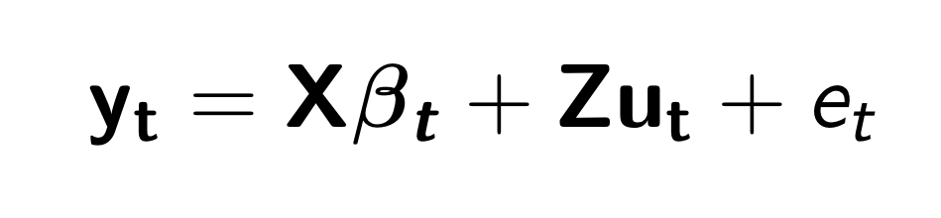
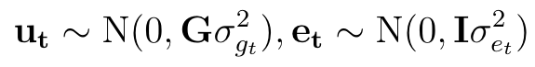
Predicting daily genetic values: univariate approach
y_{t} vector of observations at single time point
β_{t} vector of fixed effects
u_{t} vector of genetic values
e_{t} residual effects
Notes:
The most straight forward way to analyze this data is with a univariate approach

Slide 19
Predicting daily genetic values: univariate approach
y_{t} vector of observations at single time point
β_{t} vector of fixed effects
u_{t} vector of genetic values
e_{t} residual effects
e ~ N(0, I σ²_{e})
Each time point is a separate trait (finite-dimensional)
Ignore the covariance between traits

Slide 20
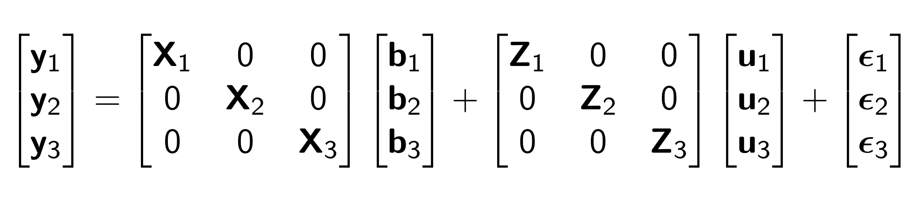
Predicting daily genetic values: multivariate approach
Each time point is a different trait (finite-dimensional)
Fully capture the covariance between traits

Slide 21
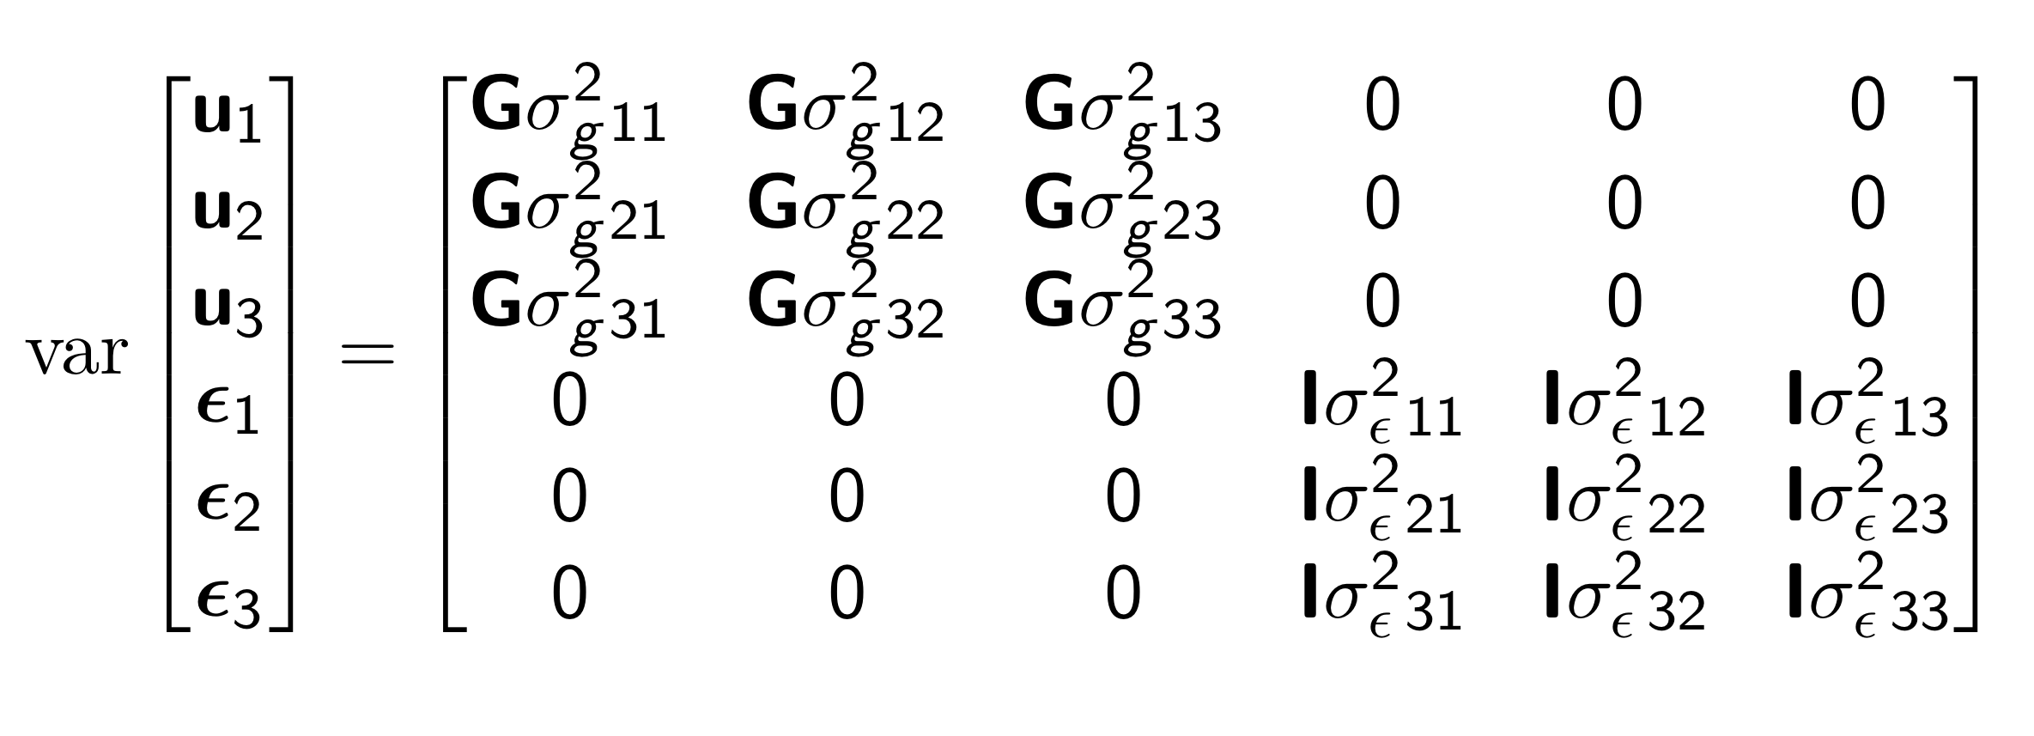
Predicting daily genetic values: multivariate approach
Each time point is a different trait (finite-dimensional)
Fully capture the covariance between traits
t variances and t(t-1)/2 covariances
Notes:
This approach may be reasonable if you have a few time points (3-5), but anything more becomes unnecessary

Slide 22
Predicting daily genetic values: random regression approach
Define a polynomial function (K) that describes the covariance of an infinite-dimensional trait as a function of time
Number of coefficients < number of time points
Notes:
A better approach is to treat the trait as what it actually is, a continuous function of time.
Define a covariance function that captures most of the covariance and solves for fewer parameters

Slide 23
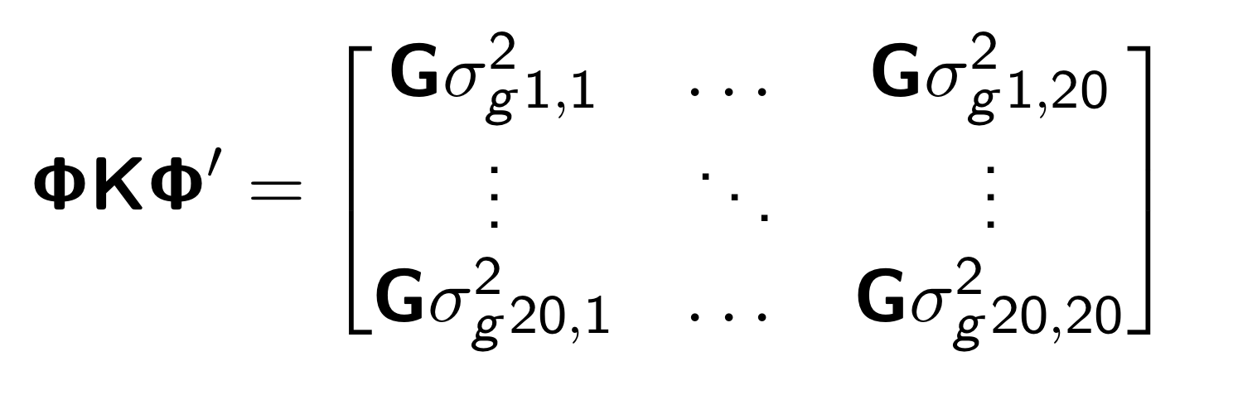
Predicting daily genetic values: random regression approach
K = 3 polynomial
k=1 intercept
k=2 linear
k=3 quadratic
Φ: Matrix of polynomials (t x k = 20 x 3)
K: Matrix of polynomial coefficients (k x k = 3 x 3)

Slide 24
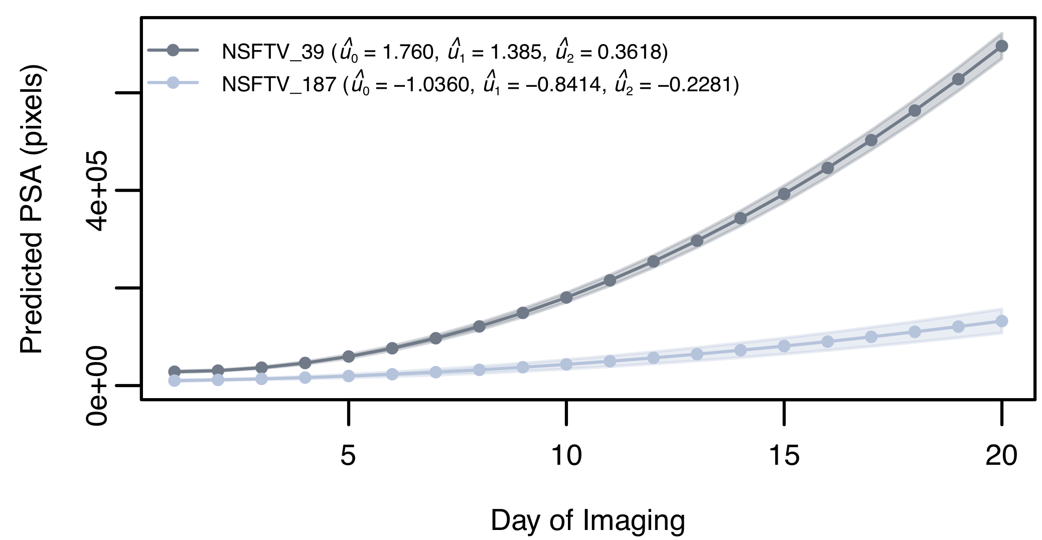
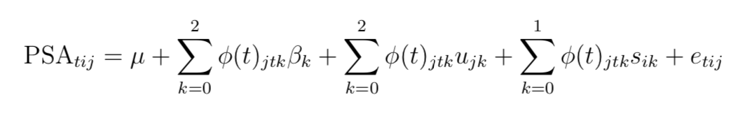
Predicting daily genetic values: random regression approach
Random temporal genetic effects
Notes:
Variation of

Slide 25
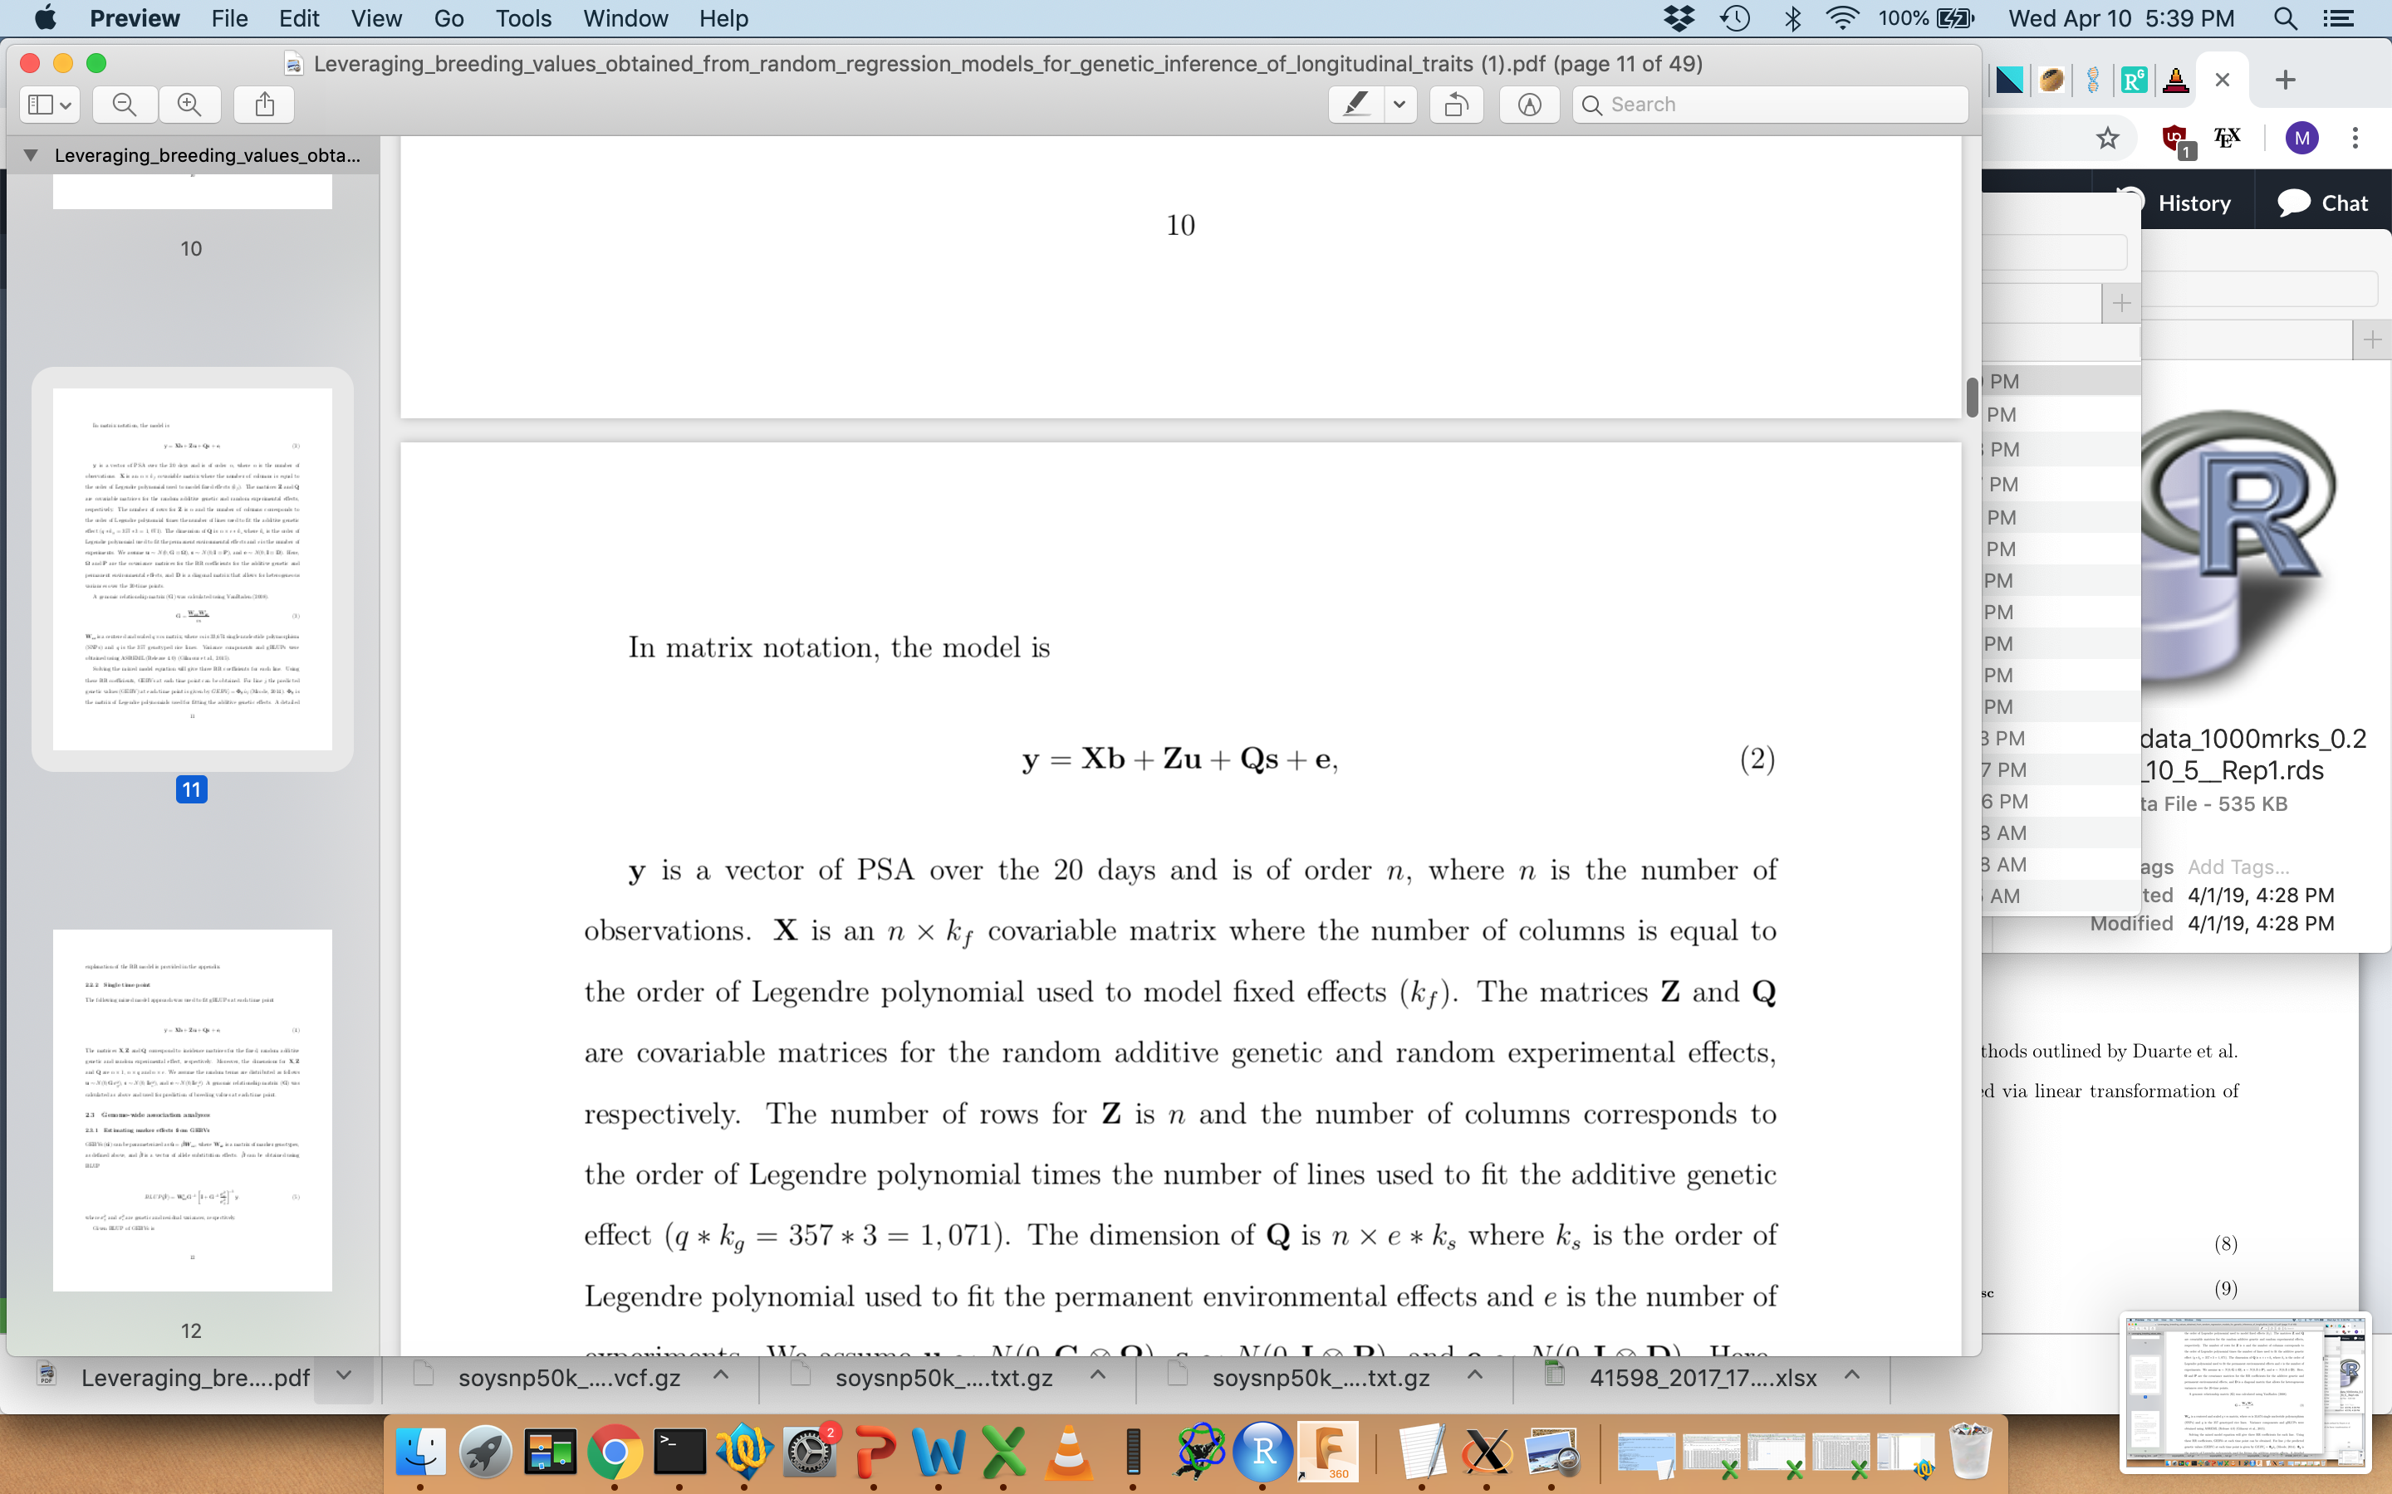
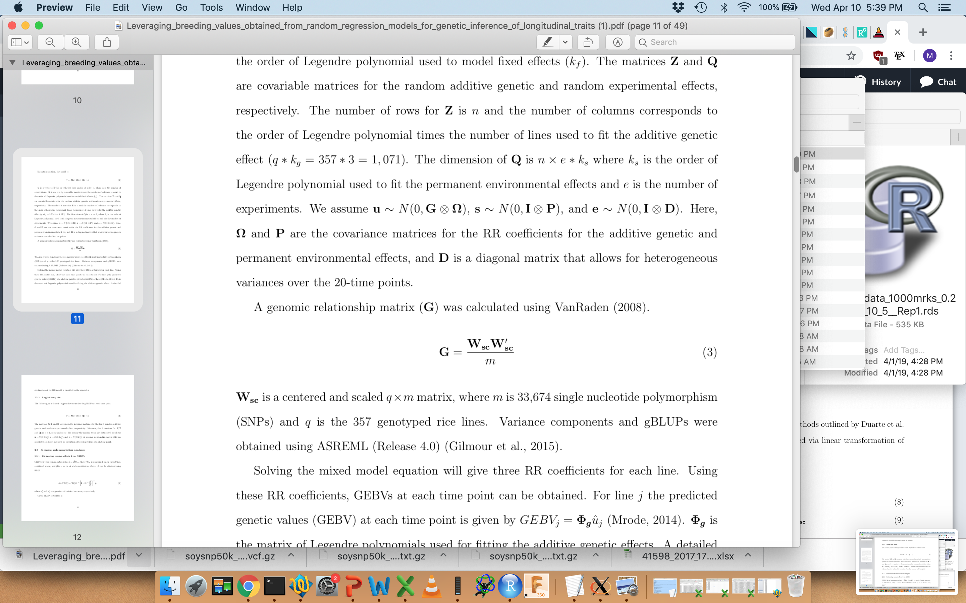
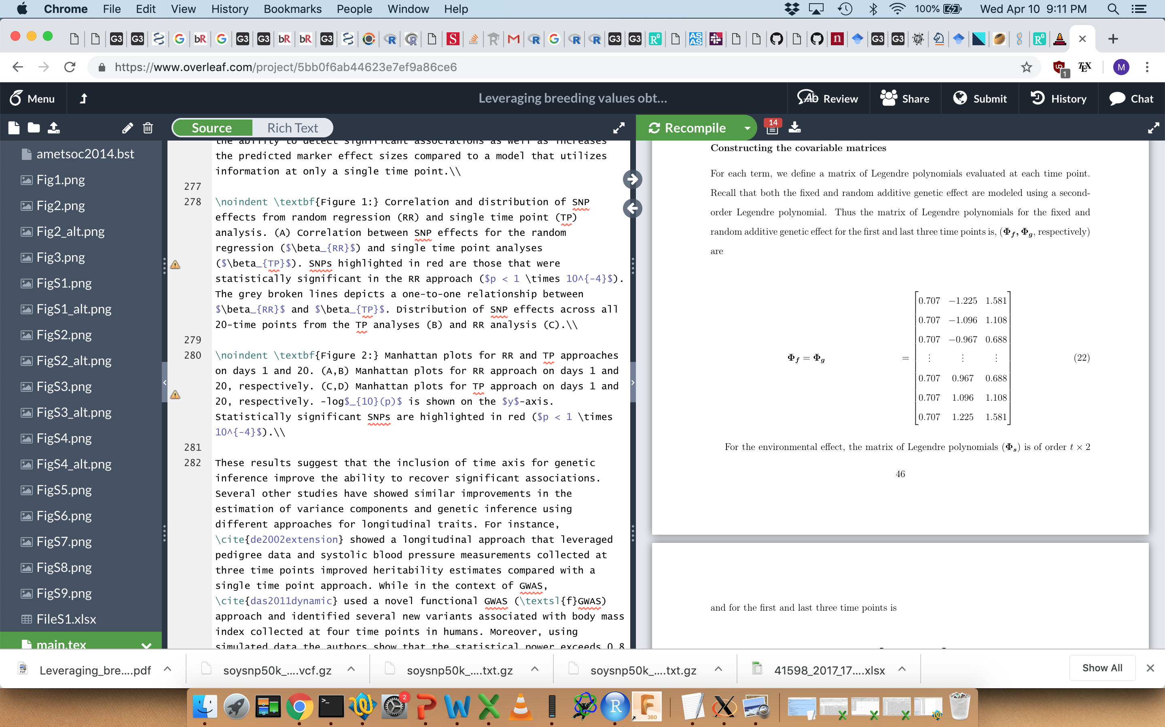
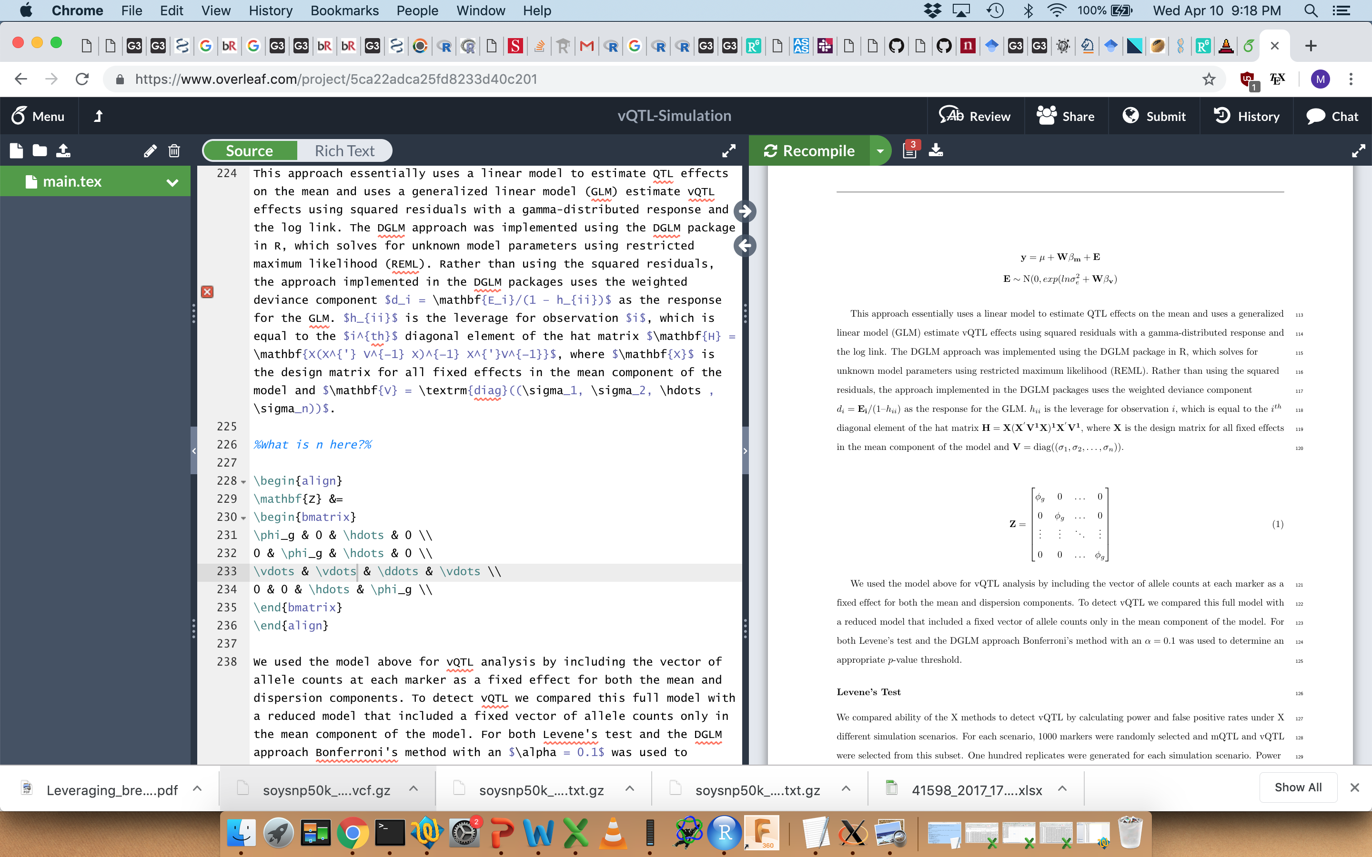
Predicting daily genetic values: random regression approach
Notes:
Variation of

Slide 26
Predicting daily genetic values: random regression approach
Notes:
Variation of

Slide 27
Genomic prediction for temporal traits
Can we predict daily genetic values for shoot biomass?
Is random regression (RR) better than the single time point (TP) approach?
Campbell et al (2018)
Notes:
What is the point of all this?

Slide 28
Genomic prediction for temporal traits
0
Time
20
Train
Train
Lines
Test
Split population into two halves (training and testing set)
Fit model using only information from training set
Predict genetic values for testing set
Correlation between genetic values (u_{t}) and PSA at each time point

Slide 29
Genomic prediction for temporal traits
12% higher prediction accuracy with RR compared to single time point (TP)
approach
35% higher at day 8
Campbell et al (2018)

Slide 30
Genomic prediction for temporal traits
Closer to
“true” values
Campbell et al (2018)
Notes:
We have a better ability to capture the genetic effects that give rise to the phenotype
The predicted values of g for the RR approach are closer to the true values

Slide 31
Genomic prediction for temporal traits
Closer to
“true” values
What are the QTL?
Campbell et al (2018)
Notes:
We have a better ability to capture the genetic effects that give rise to the phenotype
The predicted values of g for the RR approach are closer to the true values

Slide 32
Leveraging RR models to study temporal traits
Goal(s) (1) Estimate SNP effects at each time point from GEBVs
(2) Define test statistic to calculate exact p-values
Campbell et al (2019)

Slide 33
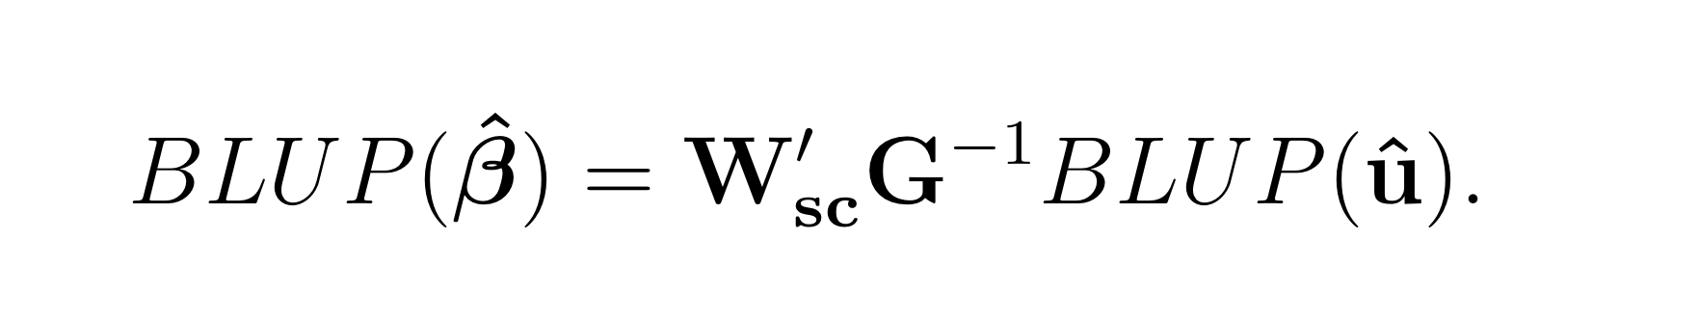
Leveraging RR models to study temporal traits
Goal(s) (1) Estimate SNP effects at each time point from GEBVs
(2) Define test statistic to calculate exact p-values
Solve for SNP effects
Campbell et al (2019)

Slide 34
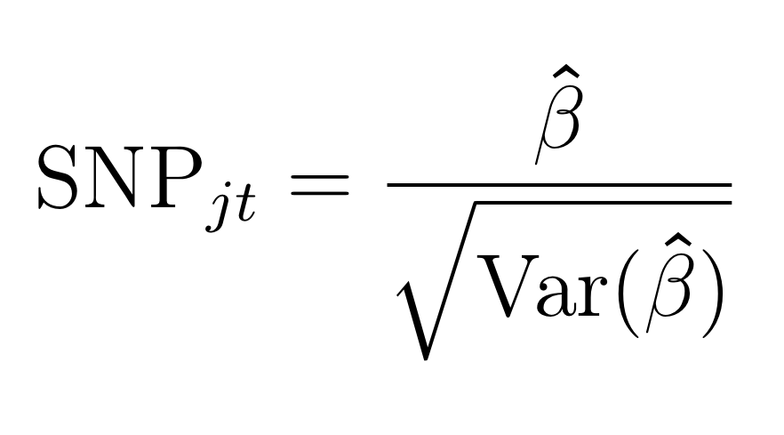
Leveraging RR models to study temporal traits
Goal(s) (1) Estimate SNP effects at each time point from GEBVs
(2) Define test statistic to calculate exact p-values
Campbell et al (2019)

Slide 35
Leveraging RR models to study temporal traits
Goal(s) (1) Estimate SNP effects at each time point from GEBVs
(2) Define test statistic to calculate exact p-values
Campbell et al (2019)

Slide 36
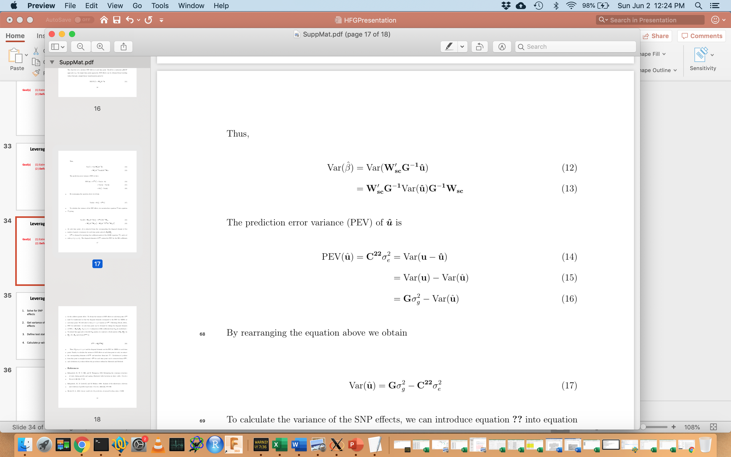
Leveraging RR models to study temporal traits
Goal(s) (1) Estimate SNP effects at each time point from GEBVs
(2) Define test statistic to calculate exact p-values
Campbell et al (2019)

Slide 37
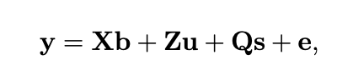
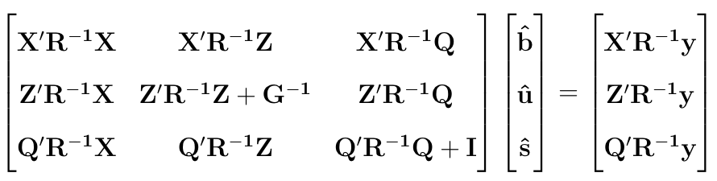
Mixed model equation for single time point (TP) approach
Campbell et al (2019)

Slide 38
Mixed model equation for single time point (TP) approach
Variance of GEBVs at each time point
q x q
Campbell et al (2019)

Slide 39
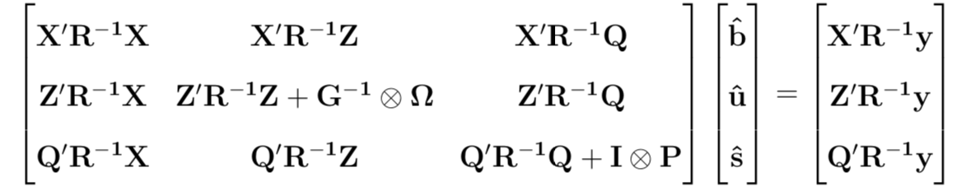
Mixed model equation for random regression (RR) approach
Campbell et al (2019)

Slide 40
Mixed model equation for random regression (RR) approach
Variance of GEBVs for RR coefficients
q*k x q*k
Campbell et al (2019)

Slide 41
Mixed model equation for random regression (RR) approach
Need to convert variance for GEBVs for RR coefficients to variance of GEBVs at each time point
To calculate GEBVs at each time point from RR-GEBVs:
Φ: Matrix of polynomials (t x k = 20 x 3)
K: Matrix of polynomial coefficients (k x k = 3 x 3)
Campbell et al (2019)

Slide 42
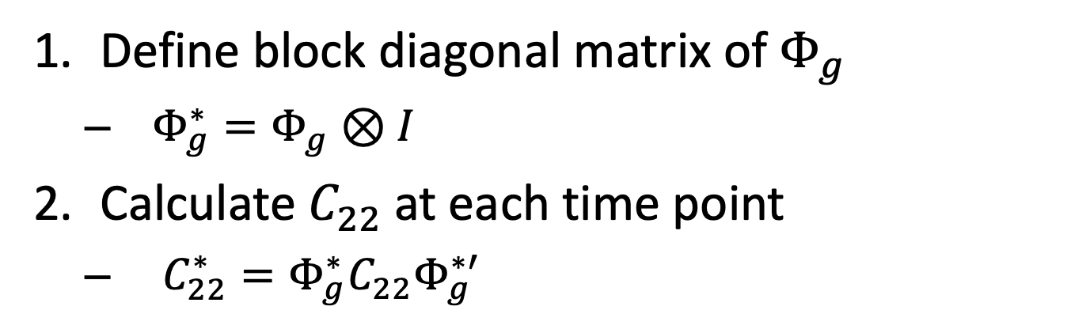
Mixed model equation for random regression (RR) approach
Define block diagonal matrix of $Φ_{g}$
$Φ_{g}^{∗}=Φ_{g}⊗I$
Calculate $C_{22}$at each time point
$C_{22}^{∗}=Φ_{g}^{∗}C_{22}Φ_{g}^{∗′}$
Campbell et al (2019)

Slide 43
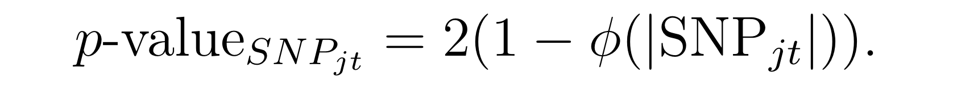
Leveraging RR models to study temporal traits
Goal(s) (1) Estimate SNP effects at each time point from GEBVs
(2) Define test statistic to calculate exact p-values
Campbell et al (2019)

Slide 44
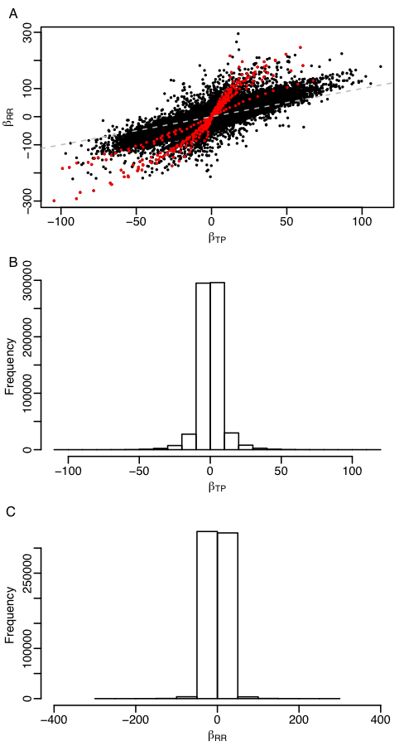
Leveraging RR models to study temporal traits
TP
Greater number of significant associations with RR compared to single time point (TP) univariate approach
RR: 442 SNPs; TP: 191 SNPs
Greater effect sizes with RR
TP: -104.6 to 112.3
RR: -299.1 to 295.0
RR
Campbell et al (2019)

Slide 45
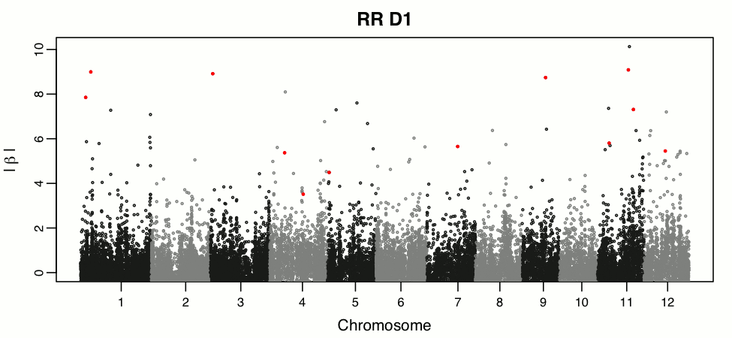
Leveraging RR models to study temporal traits
Campbell et al (2019)

Slide 46
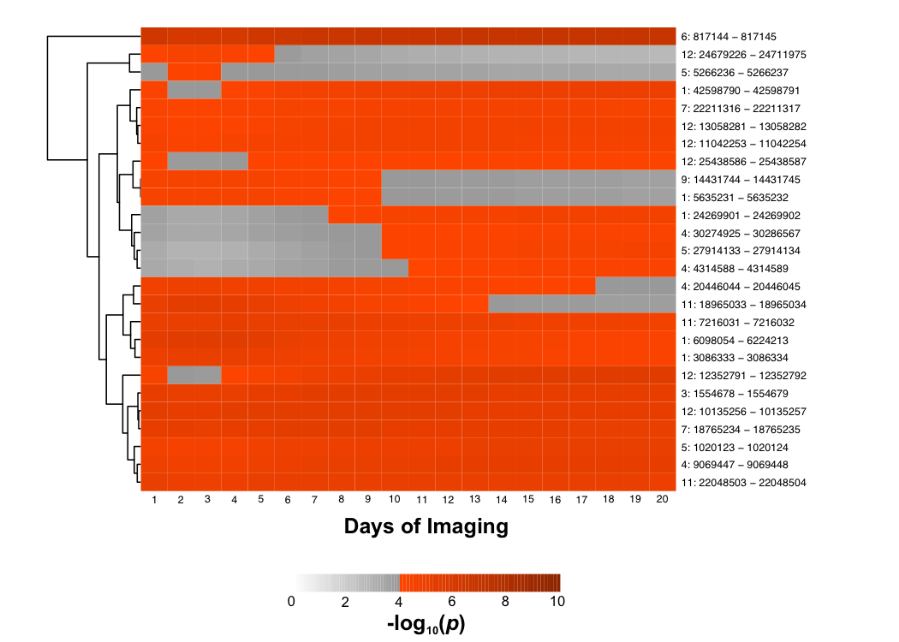
Leveraging RR models to study temporal traits
Campbell et al (2019)

Slide 47
Take-home messages
Random regression genomic prediction is flexible and powerful
Covariance function requires no prior knowledge of trait trajectory
Improves prediction accuracy compared to conventional single time point (univariate) gBLUP
Genetic values can be used for prediction and inference
Time-specific QTL

Slide 48



Acknowledgements
Morota Lab (VT): Gota Morota, Haipeng Yu, Waseem Hussain, Mehdi Momen
Walia Lab (UNL): Harkamal Walia, Aaron Schmitz, Larissa Irvin, Puneet Paul, Alex Grondin, Balpreet Dhatt, Harel Bacher, Jaspreet Sandhu, Manny Saluja, Sajag Adhikari
Wheat and Rice Center for Heat Resilience
Plant Accelerator Team: Bettina Berger, Chris Brein, Lydia Mischis
National Science Foundation (NSF)
References
Campbell, M. T., Walia, H. & Morota, G. Utilizing random regression models for genomic prediction of a longitudinal trait derived from high-throughput phenotyping. Plant Direct (2018). doi:10.1101/319897
Campbell, M.T., H. Walia, and G. Morota. 2019. Leveraging breeding values obtained from random regression models for genetic inference of longitudinal traits. Plant Genome: IN PRESS.
Henderson Jr, C. R. Analysis of covariance in the mixed model: higher-level, nonhomogeneous, and random regressions. Biometrics 623–640 (1982).
Onogi, A., M. Watanabe, T. Mochizuki, T. Hayashi, H. Nakagawa, T. Hasegawa, and H. Iwata. 2016. Toward integration of genomic selection with crop modelling: the development of an integrated approach to predicting rice heading dates. Theor. Appl. Genet. 129(4): 805–817.
Schaeffer, L. & Dekkers, J. Random regression in animal models for test-day production in dairy cattle. in Proceedings 5th World Congress Genetics Applied to Livestock Production, 1994 18, 443–446 (1994).
Zhao, K. et al. Genome-wide association mapping reveals a rich genetic architecture of complex traits in Oryza sativa. Nat. Commun. 2, 467 (2011).

